Slide 1
Icon Assets

Slide 2
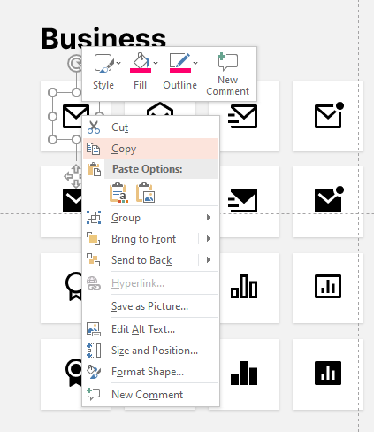

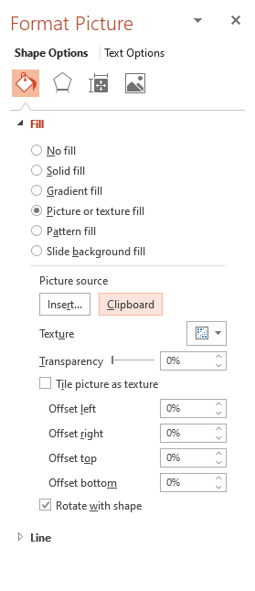

How to change icon without losing animation
01
02
03
04
And your icon is already changed without losing animation
Copy your icon
Select frame icon
Right click on you icon -> Format Picture -> Picture Source Clipboard

Slide 3
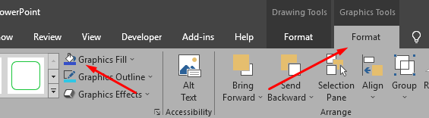
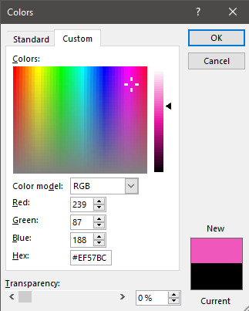
How to change icon color
01
02
Select your icon
Graphics Tools -> Graphics Fill -> Choose your colors

Slide 4
File type

Slide 5
Buildings

Slide 6
Business

Slide 7
Business

Slide 8
Communication

Slide 9
Design

Slide 10
Design & Development

Slide 11
Device

Slide 12
Document

Slide 13
Document

Slide 14
Document

Slide 15
Editor

Slide 16
Finance

Slide 17
Finance

Slide 18
Logos

Slide 19
Logos

Slide 20
Map

Slide 21
Map

Slide 22
Media

Slide 23
Media

Slide 24
Media

Slide 25
System

Slide 26
System

Slide 27
System

Slide 28
System

Slide 29
User

Slide 30


Icon resource: - https://remixicon.com
- https://www.flaticon.com
We are used flaticon.com and remix icons.
Commercial license allowed to use the content:

